Slide 1
Mediums for NC Infant Childcare Data
David Culhane

Slide 2
Billboard Next Slide (In Avery County, NC)

Slide 3
Elect Politicians
Who Support
Families and
Childcare Policies:
Jim Familyman (NC House)
Forda Khidz (NC Senate)
Wanda Help (US House)
William Passer (US Senate)
30%
What would you have to do if you had 30% less money every month?
of an Avery County family’s income can end up going to childcare costs
NC4ChildCareReform.com

Slide 4
Infographic Next Slide (To be shared online)

Slide 5
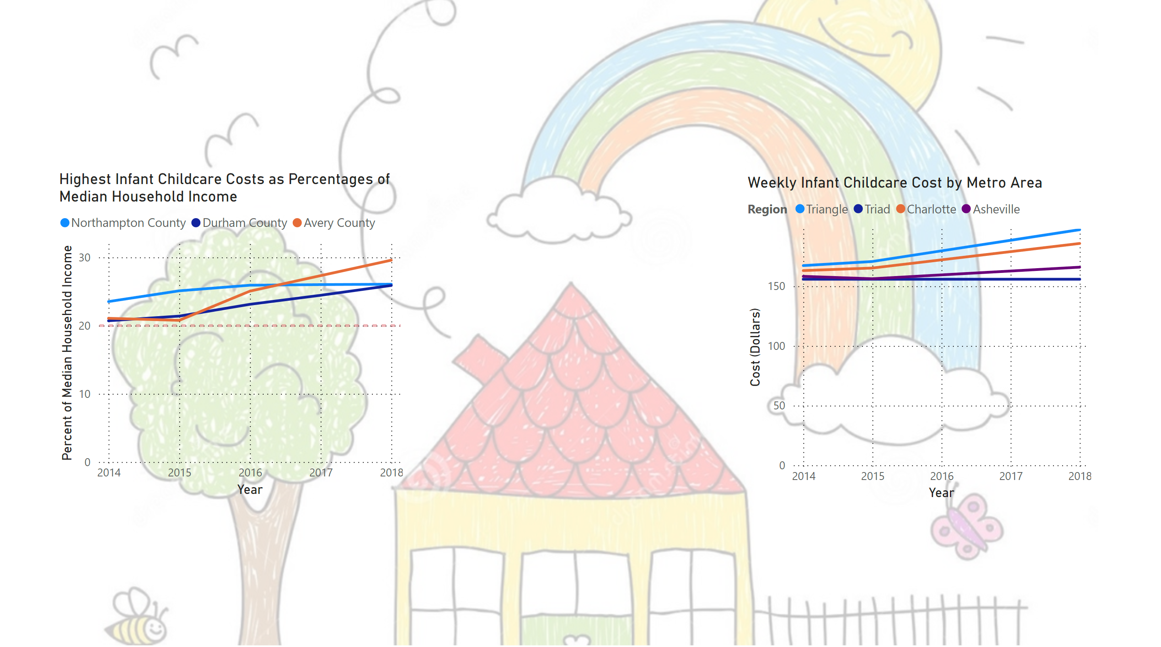
Increasing NC Childcare Costs in NC
Vote for politicians who want to make childcare more affordable for NC families:
Jim Familyman (NC House)
Forda Khidz (NC Senate)
Wanda Help (US House)
William Passer (US Senate)
Larger shares of the Median Household Income are taken up by infant childcare for families across North Carolina
Across North Carolina, weekly childcare costs grow and take up larger shares of a family’s income.
NC4ChildCareReform.com

Slide 6
PowerPoint Next Slide (To NC legislators in 2018; Visuals to be more refined later)

Slide 7
North Carolina Infant Childcare Regional Check-in
NC4ChildCareReform

Slide 8


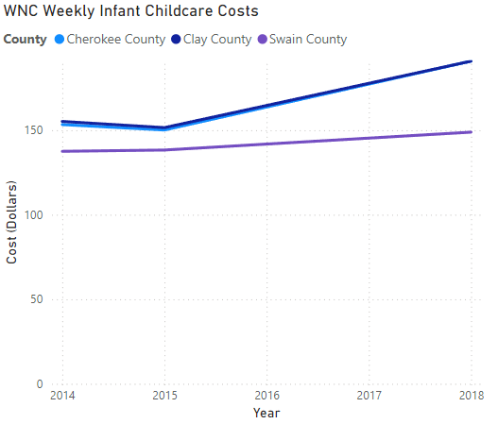

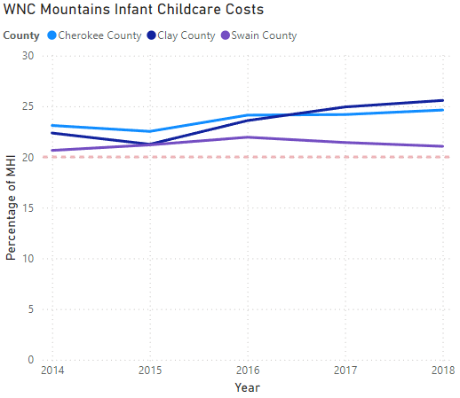
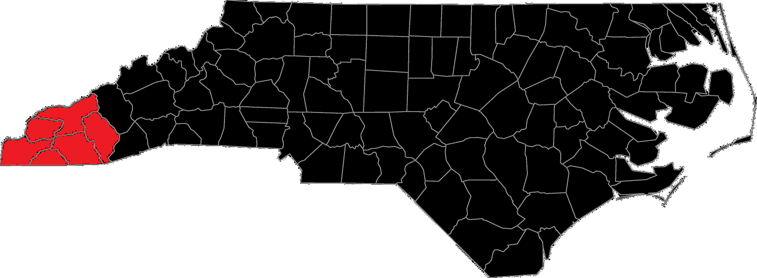
Western Mountains
Half of the region sees infant childcare costs at above 20% of MHI

Slide 9
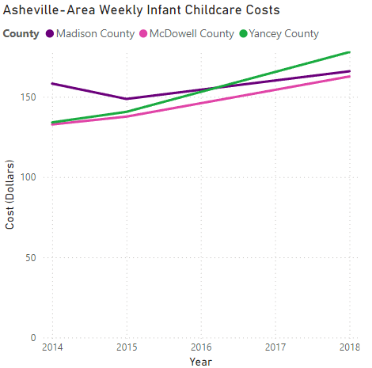
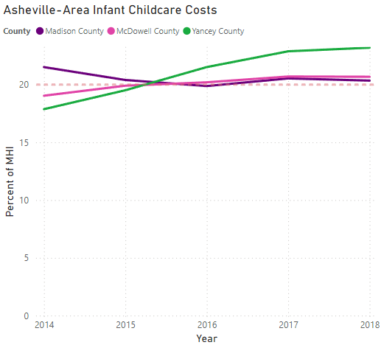
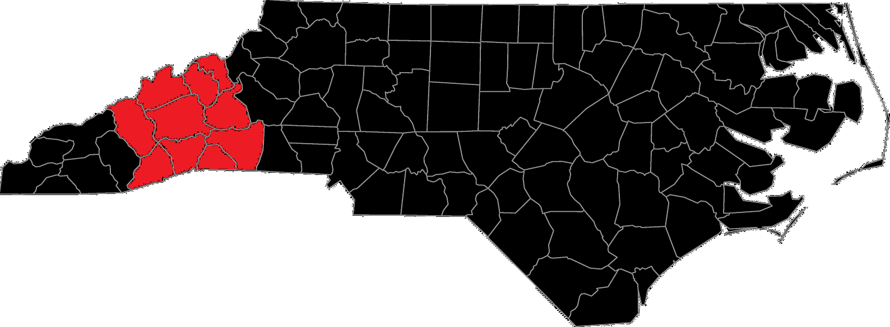
Asheville
A third of the Asheville region has childcare costs above 20% of MHI

Slide 10
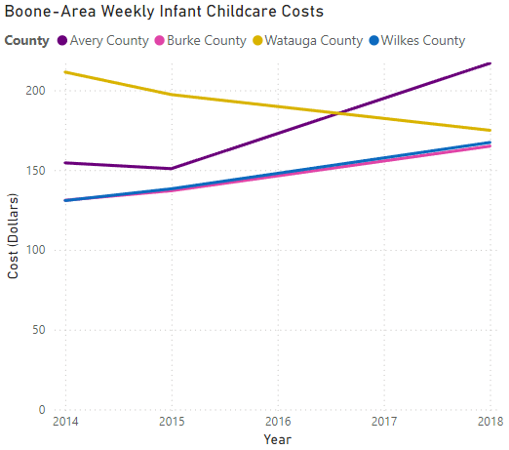
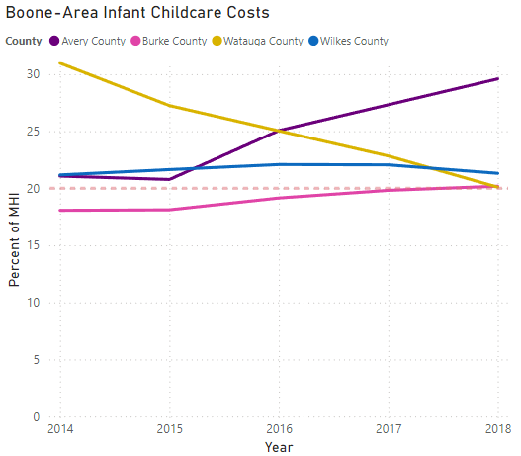
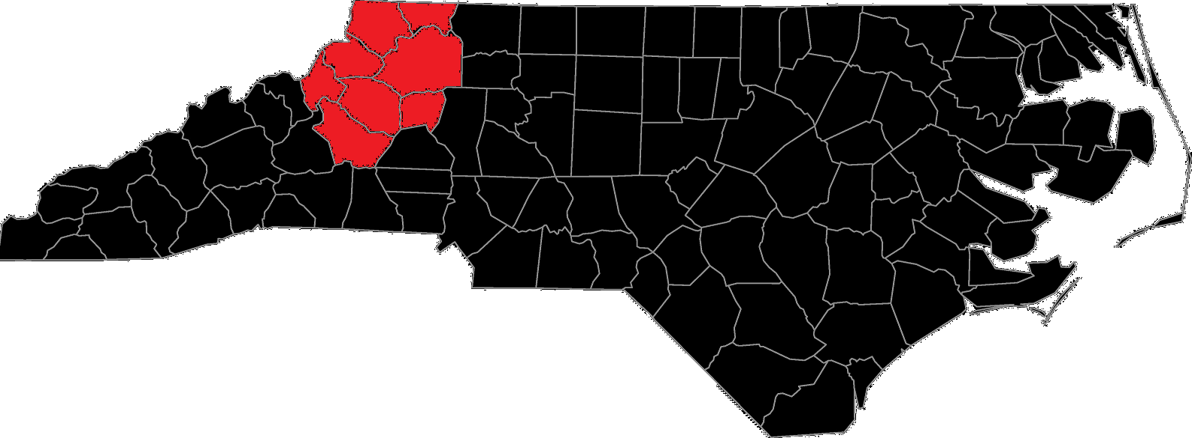
Boone
Avery County residents with newborns can expect to pay 30% of MHI just for childcare in order to work

Slide 11
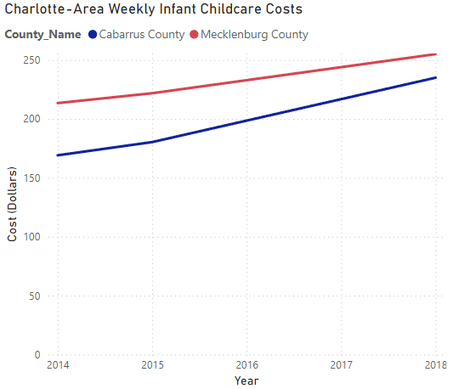
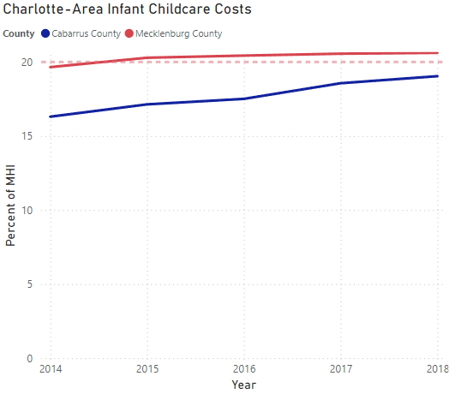
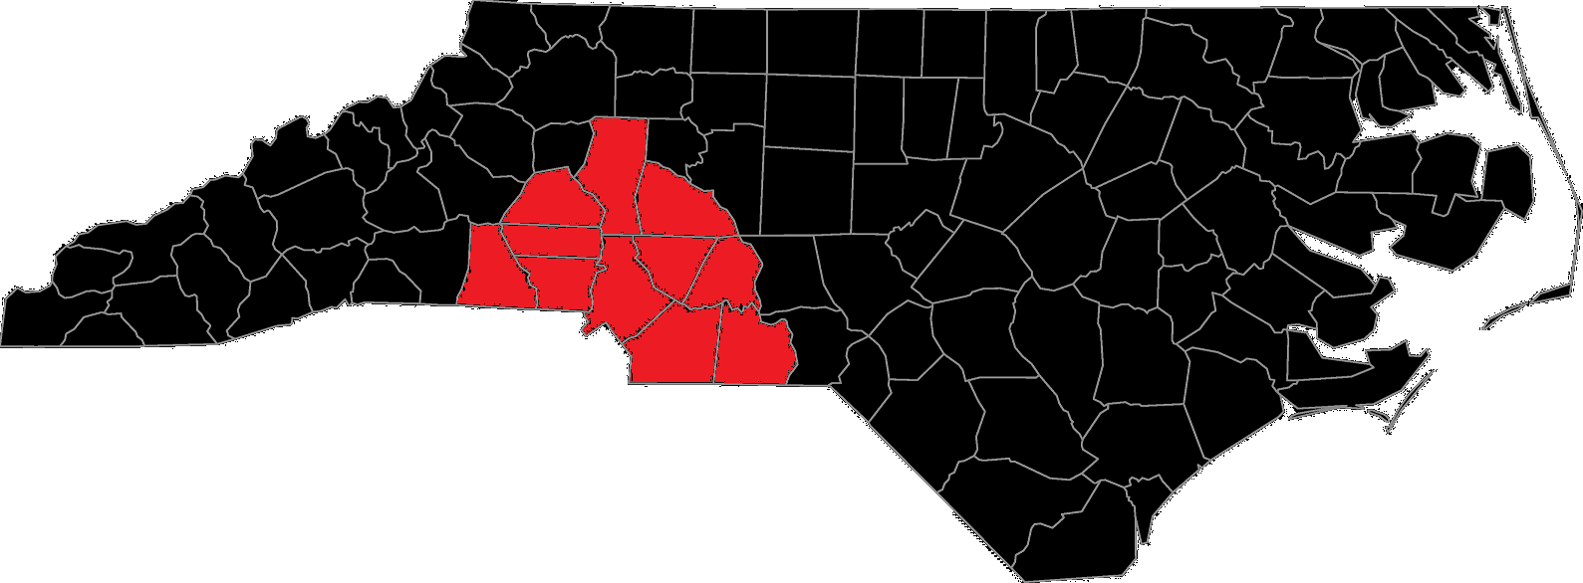
Charlotte
Only Mecklenburg County had costs sit above 20% of MHI
Actual cost increased and is 3rd highest in the state
Only eclipsed by Orange and Durham counties in actual weekly cost

Slide 12
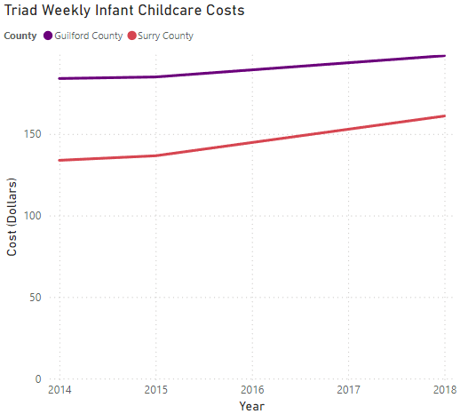
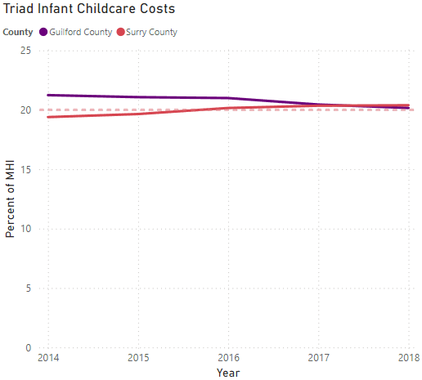
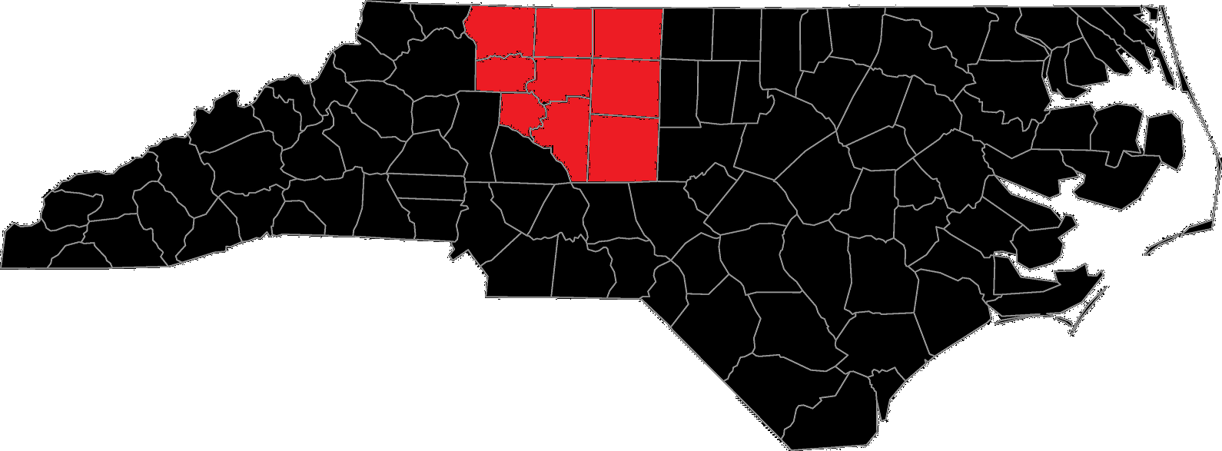
Triad
Cost as a percent of MHI stabilizing around 20%
Actual costs increasing in Guilford and Surry counties

Slide 13
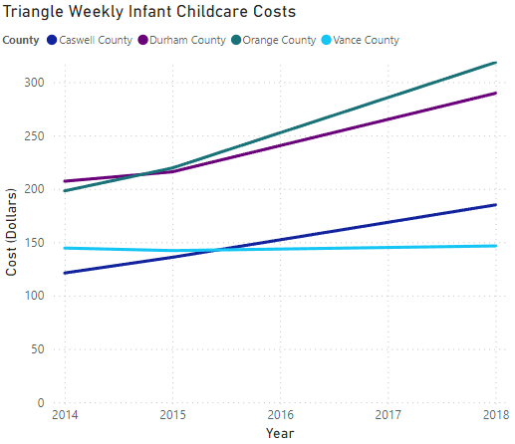
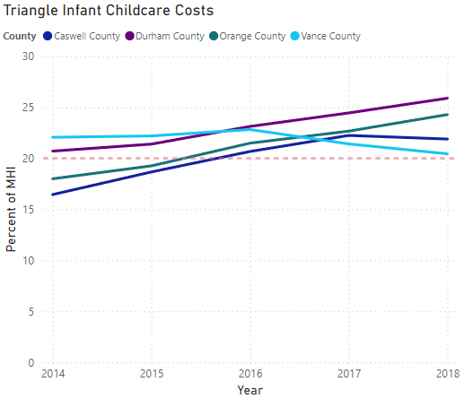
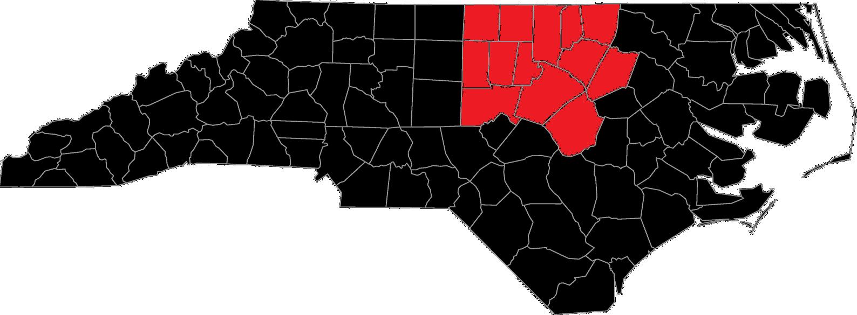
Triangle
Durham and Orange counties have highest weekly infant childcare costs in the state
Both counties in vicinity of 25% of local MHI for annual cost of infant childcare

Slide 14
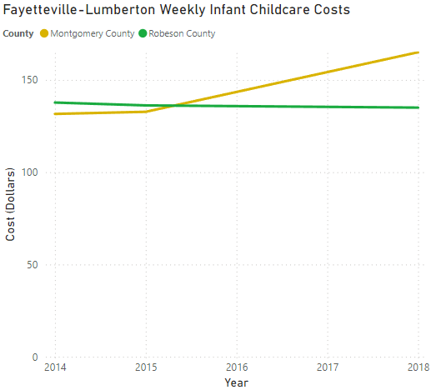
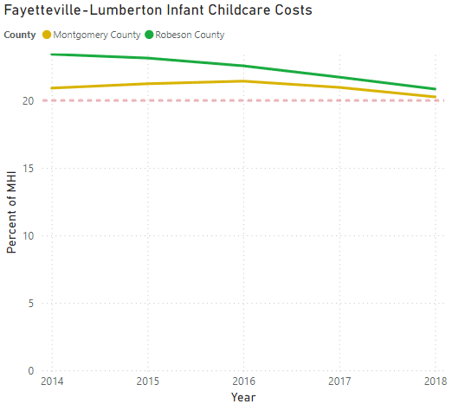
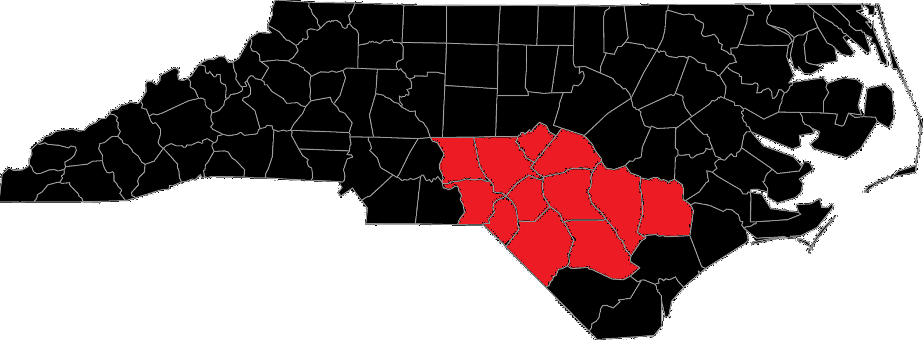
Fayetteville-Lumberton
One of two regions where costs as a percentage of MHI decreased overall
Montgomery and Robeson counties still above 20% of MHI
Montgomery County’s actual costs still increased

Slide 15
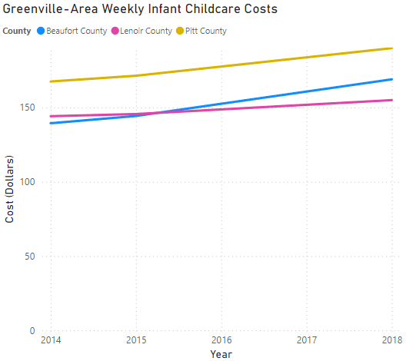
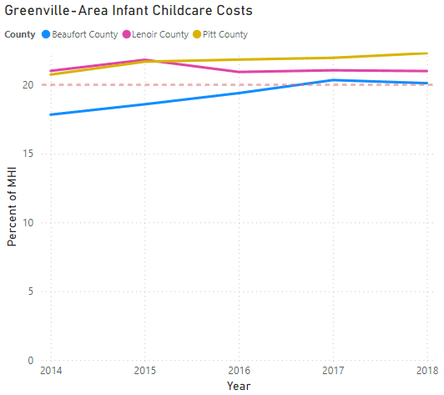
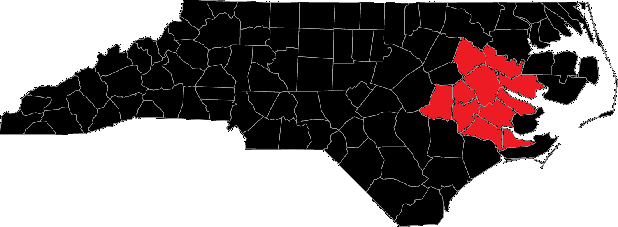
Greenville
Prices in Beaufort, Lenoir, and Pitt counties stabilizing in neighborhood of 20% of MHI
Actual costs increasing over time

Slide 16
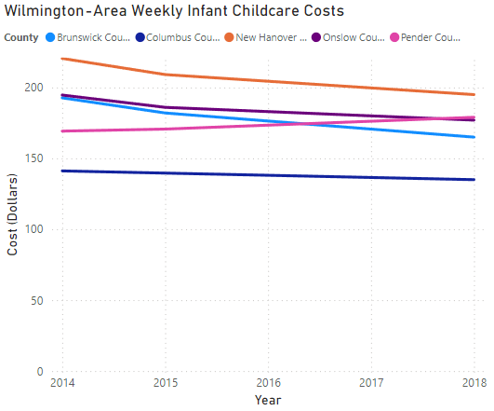
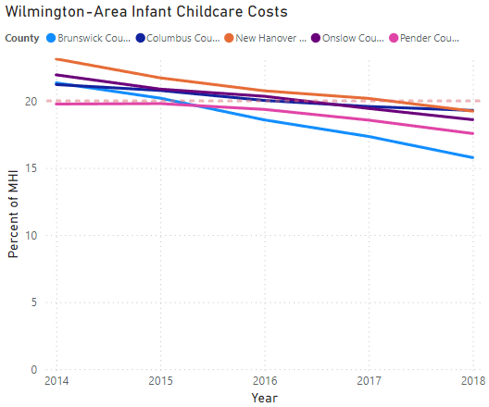
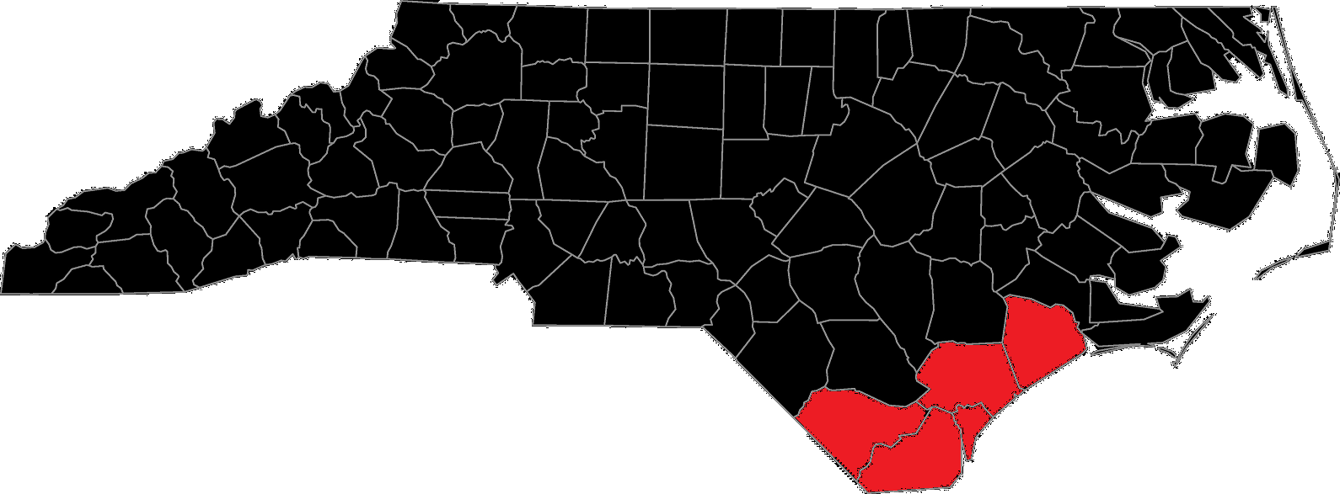
Wilmington
One of two regions where costs as a percentage of MHI went down
Actual costs remained mostly stable, with minor decreases
Region started near or above 20% of MHI in 2014

Slide 17
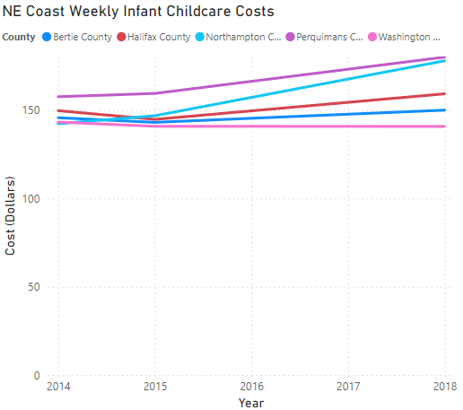
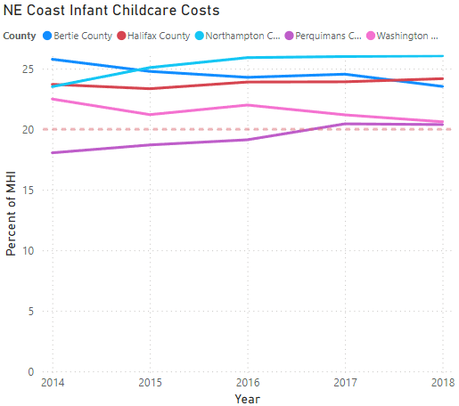
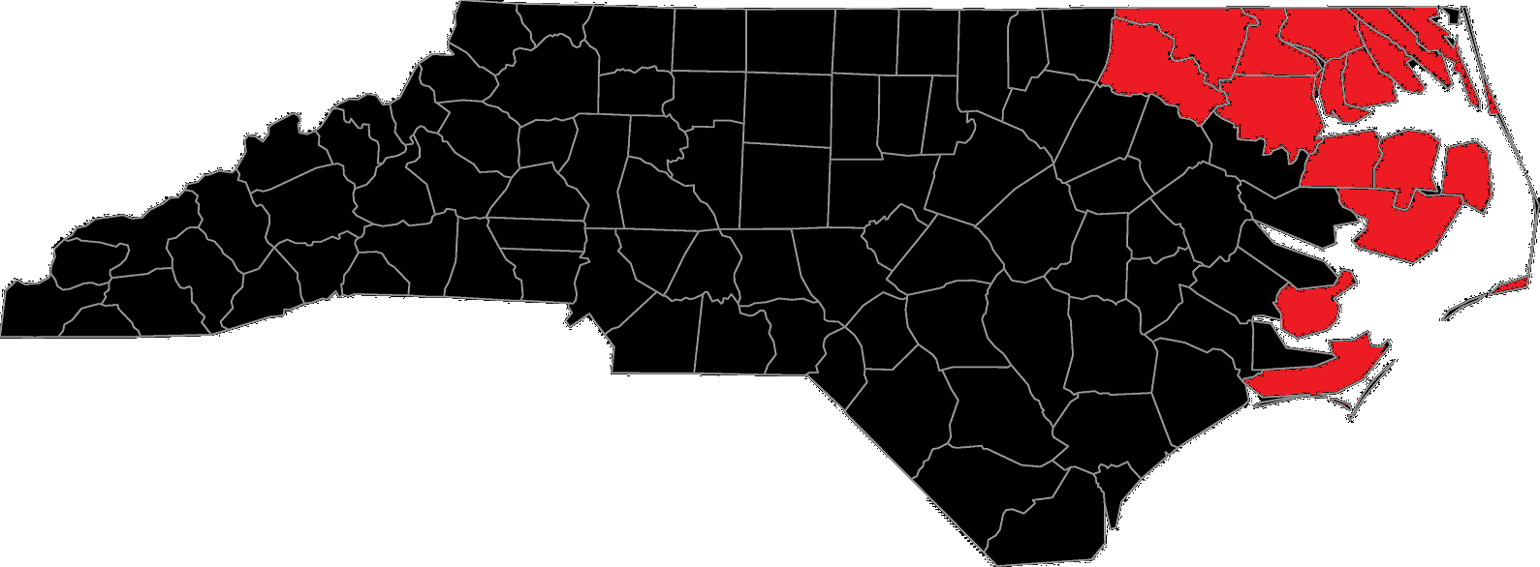
Northeast and Coastal NC
Contains highest number of counties with infant childcare costs greater than 20% of MHI
Similar weekly cost to Greenville-area but larger share of MHI

Slide 18
Conclusion & Policy Suggestions
27 of NC’s 100 counties pay more than 20% of local MHI for infant childcare
Increasing NC Child Tax Credit value and widening brackets would benefit families and could encourage citizens to start families
Much of the state can see $150 per week, translating to $7,800 per year for infant childcare
Providing registered and certified day care facilities with subsidies would save facilities money and those savings could be passed to families

